Slide 1
Vocational Training Teams
District 5630
2013 - 2014

Slide 2
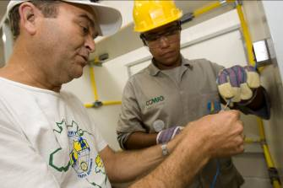
Vocational Training Teams
Traveling groups of professionals
Learn about vocation
Teach professionals about particular field
Strengthen knowledge and skills

Slide 3
Getting Started
Strengths
Knowledge
Skills
Resources
Needs = areas in which training could be beneficial

Slide 4
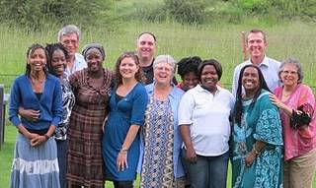
Funding
Global grants
District grants

Slide 5
Global Grants
Align with area of focus
Build capacity
Sustainable and measurable
Minimum budget: $30,000
Host and international sponsor
1 Rotarian team leader and at least 2 team members

Slide 6
Global Grants - Benefits
No restrictions on participant age
No restrictions on length of training
More than one team permitted under each grant
Additional participants

Slide 7
District Grants
Align with the mission
Support many types of teams:
Traditional GSE
Training
Experience host country culture
Observe professions
Exchange ideas
Lead training courses

Slide 8
District Grant Benefits
Tremendous flexibility
No restrictions on participant age
No restrictions on length of training

Slide 9
District Grant Examples
District 6200 (USA) – District 9600 (Australia, Papua New Guinea, Solomon Islands): environmental impact of oil spills
District 9270 (South Africa): teacher training

Slide 10
Resources
Rotary E-Learning Center
Rotary Grant News

Slide 11
Questions?
Dr Toni Hill
hilltl@unk.edu
402-201-4945

